Slide 1
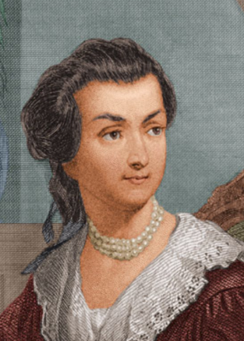
Abigail Smith Adams
<https://tinyurl.com/dl20180226a>: Letter to John Adams 31 Mar-5 Apr 1776: Things to note about the letter as you read it:
Speling…
Public concerns:
Suspicion of Virginia…
State of Boston after the occupation…
Power of the colonies to resist…
Soapmaking… saltpeter… gunpowder…
Private concerns:
Family security…
“Gorge the Eldest… Billy the youngest… Becky Peck… your brother’s youngest child lies bad with convulsion fits…”
Why don’t you write more, and at longer length?
Feminist concerns…
audio track?
https://github.com/braddelong/public-files/blob/master/%23feminism-%23demography-lecture-abigail-smith-adams.pdf
Notes:
I like to either start or close lectures about gender roles, patriarchy, and inclusion with a letter from Abigail Smith Adams to her husband, future president John Adams, that she wrote in 1776 at the age of 32. (He was then 42.) It is a famous letter. It is, to my mind, one of the most interesting windows into the dilemmas of a very smart and very uneducated upper class late 1700s century woman wanting more scope for herself and her life then society’s gender roles were willing to offer her. I would love to lecture on it here for another half an hour. But I am already over time for this lecture…

Slide 2
Demanding Knowledge on Public Affairs—Mostly Questions About Massachusetts’s Virginia Allies
And she has strong opinions about public affairs:
Braintree March 31, 1776: I wish you would ever write me a Letter half as long as I write you; and tell me if you may:
Where your Fleet are gone?
What sort of Defence Virginia can make against our common Enemy?
Whether it is so situated as to make an able Defence?
Are not the Gentery Lords and the common people vassals?
Are they not like the uncivilized Natives Brittain represents us to be?
I hope their Riffel Men who have shewen themselves very savage and even Blood thirsty; are not a specimen of the Generality of the people.
I [illegible] am willing to allow the Colony great merrit for having produced a Washington but they have been shamefully duped by a Dunmore.
I have sometimes been ready to think that the passion for Liberty cannot be Eaquelly Strong in the Breasts of those who have been accustomed to deprive their fellow Creatures of theirs. Of this I am certain that it is not founded upon that generous and christian principal of doing to others as we would that others should do unto us…

Slide 3
The Letter: Focus on Feminist Concerns
Introduced in a “by the way”—cf. Alexandra Petri: A Woman, in a Meeting <https://www.bradford-delong.com/2020/07/petri-2015-woman.html>:
I long to hear that you have declared an independency—and by the way in the new Code of Laws which I suppose it will be necessary for you to make I desire you would Remember the Ladies, and be more generous and favourable to them than your ancestors. Do not put such unlimited power into the hands of the Husbands. Remember all Men would be tyrants if they could. If perticuliar care and attention is not paid to the Laidies we are determined to foment a Rebelion, and will not hold ourselves bound by any Laws in which we have no voice, or Representation.
That your Sex are Naturally Tyrannical is a Truth so thoroughly established as to admit of no dispute, but such of you as wish to be happy willingly give up the harsh title of Master for the more tender and endearing one of Friend. Why then, not put it out of the power of the vicious and the Lawless to use us with cruelty and indignity with impunity? Men of Sense in all Ages abhor those customs which treat us only as the vassals of your Sex. Regard us then as Beings placed by providence under your protection and in immitation of the Supreem Being make use of that power only for our happiness…

Slide 4
The Letter: What Things She Is Doing While He Is Away in Philadelphia at the Continental Congress
Running his Boston-Braintree farming-real estate operation:
Not just the domestic “inside the household” part: the whole thing
Do not you want to see Boston? I am fearfull of the small pox, or I should have been in before this time.
I got Mr. Crane to go to our House and see what state it was in. I find it has been occupied by one of the Doctors of a Regiment, very dirty, but no other damage has been done to it. The few things which were left in it are all gone. Cranch has the key which he never deliverd up. I have wrote to him for it and am determined to get it cleand as soon as possible and shut it up. I look upon it a new acquisition of property, a property which one month ago I did not value at a single Shilling, and could with pleasure have seen it in flames.
The Town in General is left in a better state than we expected, more oweing to a percipitate flight than any Regard to the inhabitants, tho some individuals discoverd a sense of honour and justice and have left the rent of the Houses in which they were, for the owners and the furniture unhurt, or if damaged sufficent to make it good.
Others have committed abominable Ravages. The Mansion House of your President is safe and the furniture unhurt whilst both the House and Furniture of the Solisiter General have fallen a prey to their own merciless party. Surely the very Fiends feel a Reverential awe for Virtue and patriotism, whilst they Detest the paricide and traitor.
Military logistics:
You inquire of whether I am making Salt peter. I have not yet attempted it, but after Soap making believe I shall make the experiment. I find as much as I can do to manufacture cloathing for my family which would else be Naked. I know of but one person in this part of the Town who has made any, that is Mr. Tertias Bass as he is calld who has got very near an hundred weight which has been found to be very good. I have heard of some others in the other parishes. Mr. Reed of Weymouth has been applied to, to go to Andover to the mills which are now at work, and has gone.
I have lately seen a small Manuscrip describing the proportions for the various sorts of powder, such as fit for cannon, small arms and pistols [illegible]. If it would be of any Service your way I will get it transcribed and send it to you.
Dealing with disease and death:
Not having an opportunity of sending this I shall add a few lines more; tho not with a heart so gay. I have been attending the sick chamber of our Neighbour Trot whose affliction I most sensibly feel but cannot discribe, striped of two lovely children in one week. Gorge the Eldest died on wedensday and Billy the youngest on fryday, with the Canker fever, a terible disorder so much like the throat distemper, that it differs but little from it. Betsy Cranch has been very bad, but upon the recovery. Becky Peck they do not expect will live out the day. Many grown persons are now sick with it, in this street. It rages much in other Towns. The Mumps too are very frequent. Isaac is now confined with it.
Our own little flock are yet well. My Heart trembles with anxiety for them. God preserve them.
Your Brothers youngest child lies bad with convulsion fitts. Adieu.

Slide 5
The Letter: Pleas for More Information, Contact, & Context
Pleas for more information:
I wish you would ever write me a Letter half as long as I write you
I want to hear much oftener from you than I do.
March 8 [John to Abigail, 08 March 1776] was the last date of any that I have yet had.
Every one of your Friends send their Regards, and all the little ones.
I need not say how much I am Your ever faithfull Friend…
Emotional labor at the hearth:
I feel very differently at the approach of spring to what I did a month ago. We knew not then whether we could plant or sow with safety, whether when we had toild we could reap the fruits of our own industery, whether we could rest in our own Cottages, or whether we should not be driven from the sea coasts to seek shelter in the wilderness, but now we feel as if we might sit under our own vine and eat the good of the land.
I feel a gaieti de Coar to which before I was a stranger. I think the Sun looks brighter, the Birds sing more melodiously, and Nature puts on a more chearfull countanance. We feel a temporary peace, and the poor fugitives are returning to their deserted habitations.
Tho we felicitate ourselves, we sympathize with those who are trembling least the Lot of Boston should be theirs. But they cannot be in similar circumstances unless pusilanimity and cowardise should take possession of them. They have time and warning given them to see the Evil and shun it…
Is this alliance with the slaveholders of Virginia wise?
I have sometimes been ready to think that the passion for Liberty cannot be Eaquelly Strong in the Breasts of those who have been accustomed to deprive their fellow Creatures of theirs. Of this I am certain that it is not founded upon that generous and christian principal of doing to others as we would that others should do unto us…

Slide 6
Abigail Smith Adams: Social Roles
Time Spent Eating for Two:
Born 1744; in 1764 Abigail Smith (20) married John Adams (30) in 1764:
Children:
Abigail ("Nabby") 1765–1813, John Quincy Adams 1767–1848, Grace Susanna ("Suky") 1768–70, Charles 1770–1800, Thomas Boylston Adams 1772–1832
?? Possible miscarriage 1774, possible miscarriage 1775-6
Elizabeth (stillborn) 1777; total of 8
Then they stopped, when she was 34…
Likely wetnursed…
Eight pregnancies to have four survive beyond the age of ten…
This is, actually, low child mortality for THE DAY…
“Have a baby, lose a tooth…”
Social Roles:
Married at 20 from her father’s house—no time as a “Lowell mill girl” or anything else
No formal schooling (as you can see from her spelling)
Not present at husband's presidential inauguration: then caring for her dying mother…
At 74: "Do not grieve, my friend, my dearest friend. I am ready to go. And John, it will not be long." 1744

Slide 7
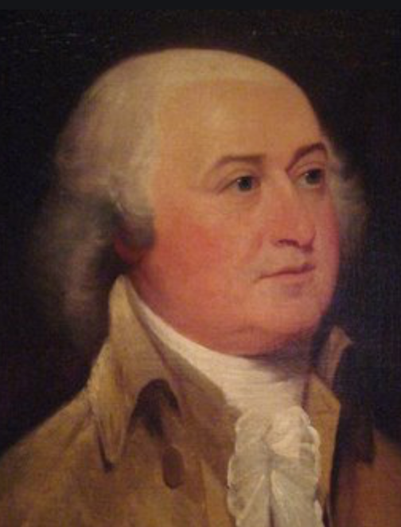
John Adams’s Reply to Abigail
As to your extraordinary code of laws, I cannot but laugh.
We have been told that our struggle has loosened the bonds of government everywhere; that children and apprentices were disobedient; that schools and colleges were grown turbulent; that Indians slighted their guardians, and negroes grew insolent to their masters.
But your letter was the first intimation that another tribe, more numerous and powerful than all the rest, were grown discontented.
This is rather too coarse a compliment, but you are so saucy, I won't blot it out.
Depend upon it, we know better than to repeal our masculine systems. Although they are in full force, you know they are little more than theory. We dare not exert our power in its full latitude. We are obliged to go fair and softly, and, in practice, you know we are the subjects.
We have only the name of masters, and rather than give up this, which would completely subject us to the despotism of the petticoat, I hope General Washington and all our brave heroes would fight.

Slide 8
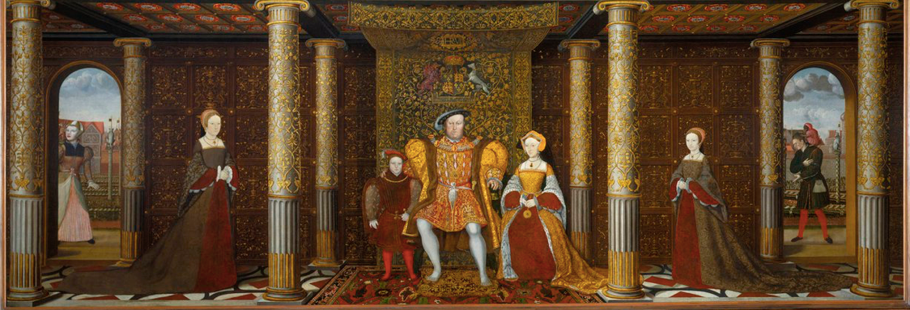
Deaths in Childbed: British Queens
The most cosseted and highest status women in the British isles:
16 generations from Henry IV to Victoria
5 queens or heiresses apparent dead in childbed: Charlotte (Victoria’s generation), Catherine Parr, Jane Seymour, Elizabeth of York, Mary de Bohun
At an average of two queens plus heiresses apparent per generation, this is a 16% childbed mortality rate
2% maternal mortality per birth…
1%? extra mortality per child from caring for sick children…

